Slide 1

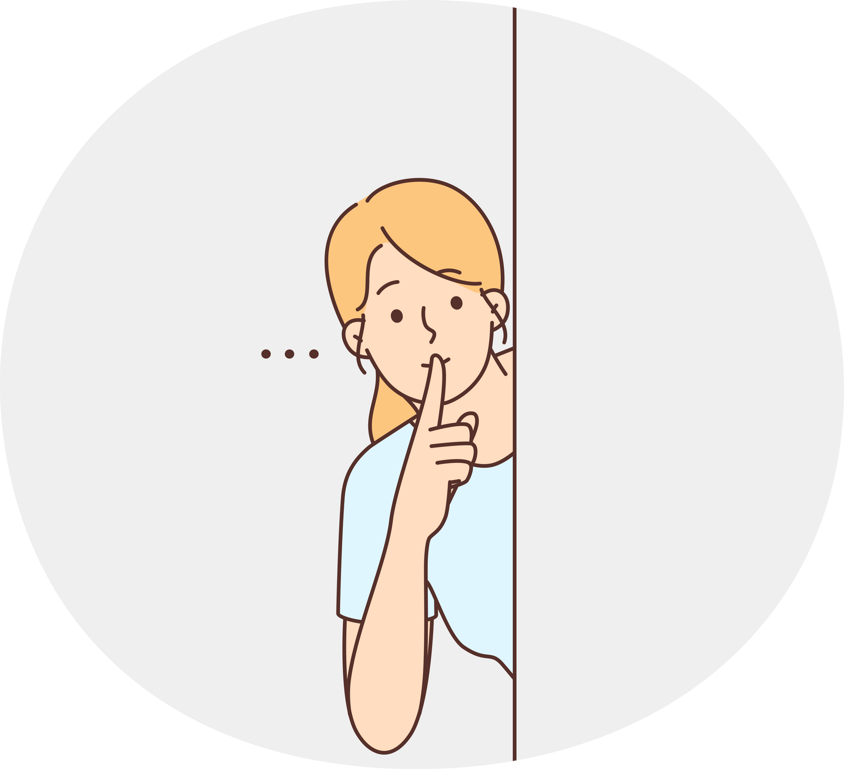
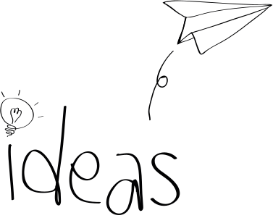


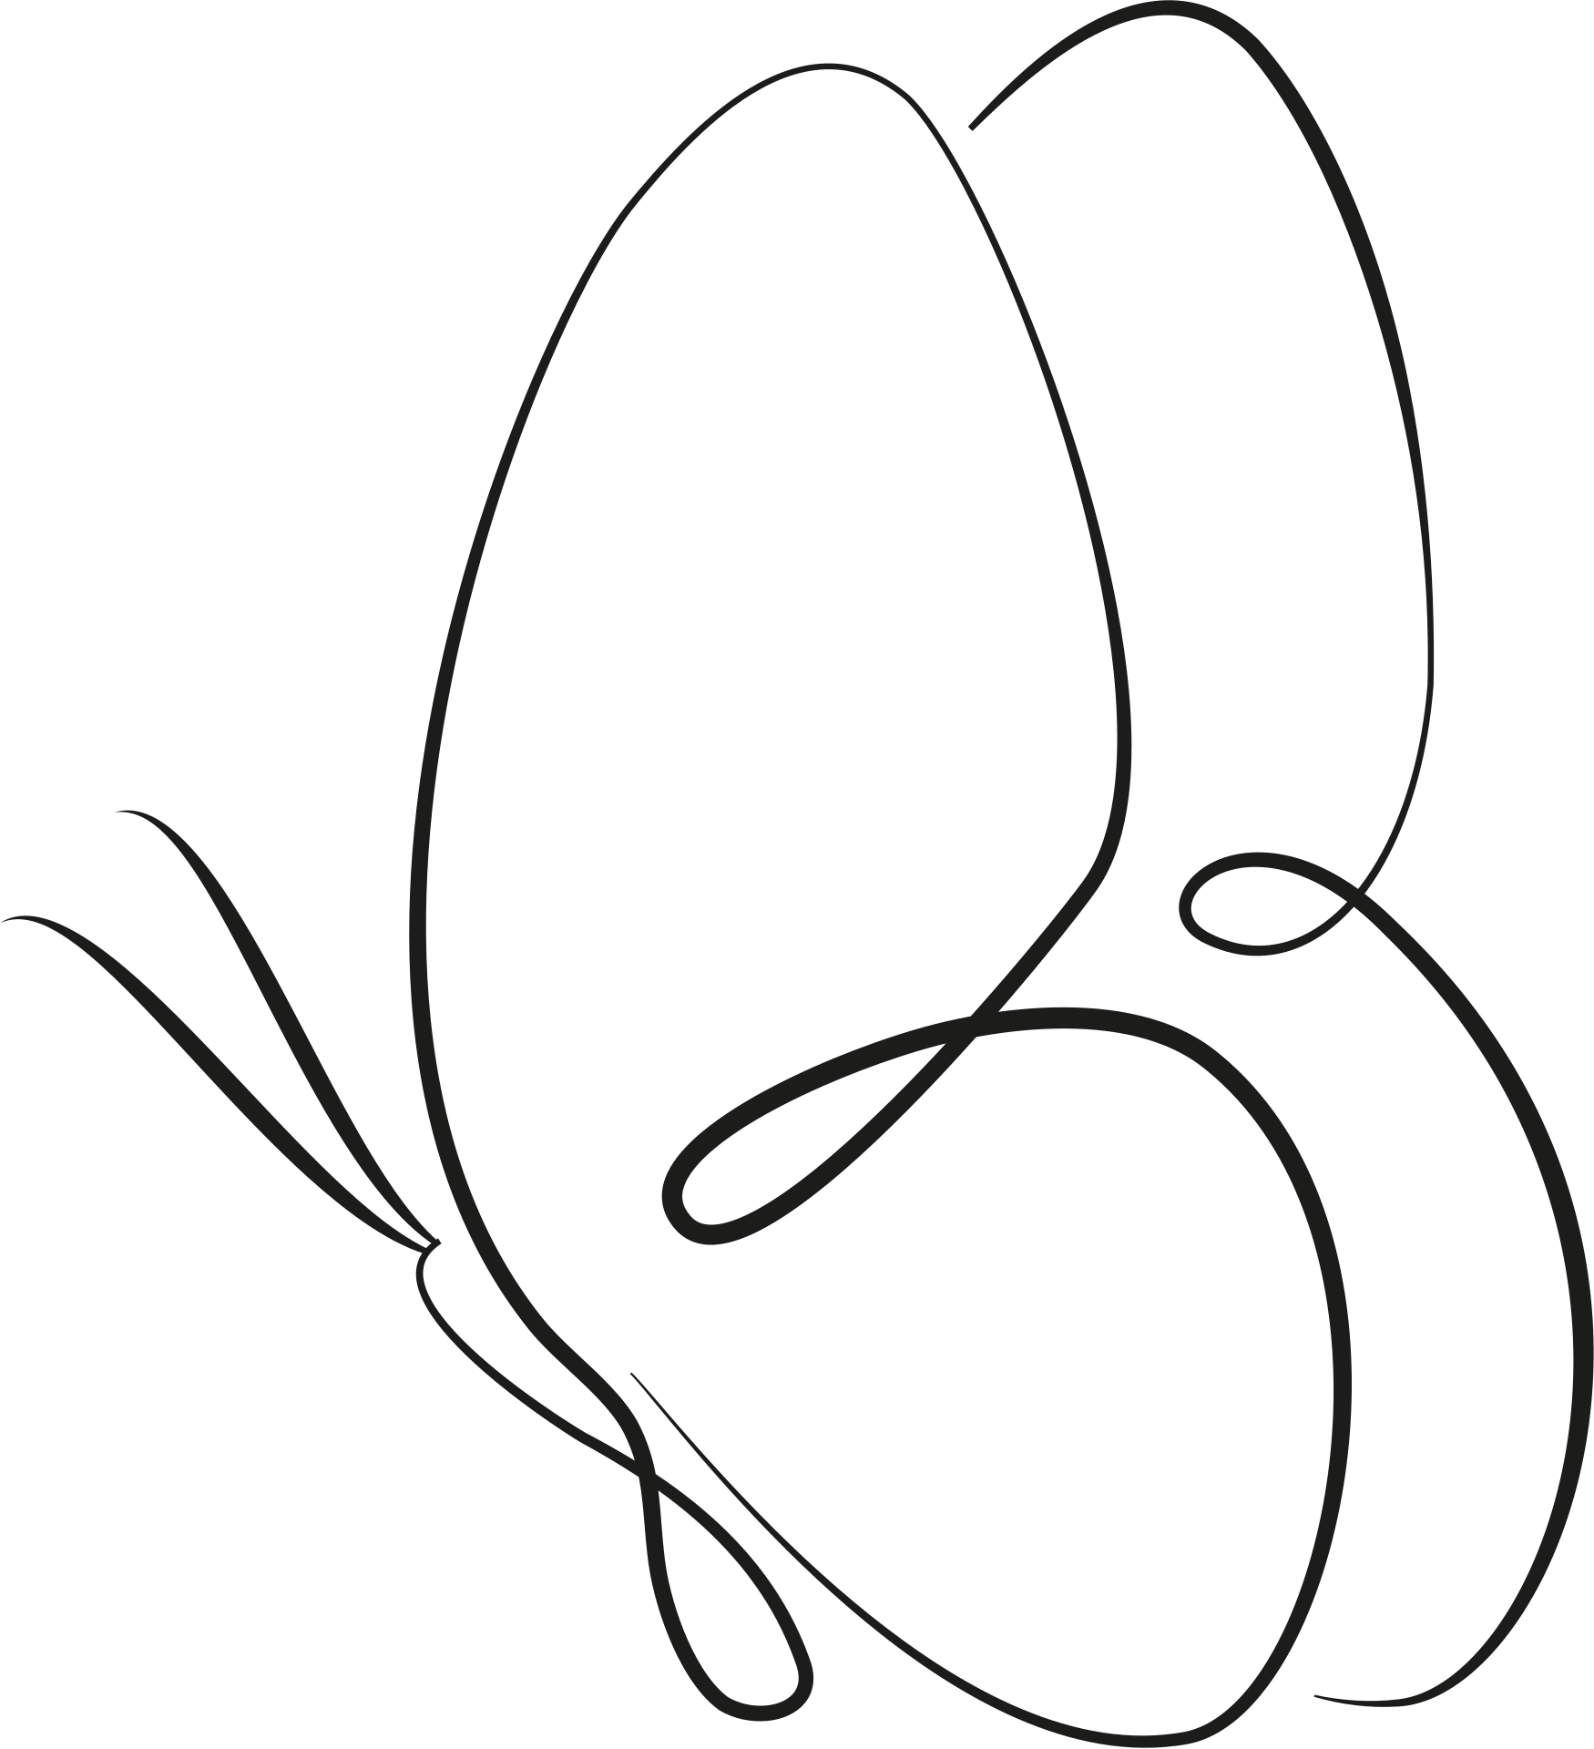

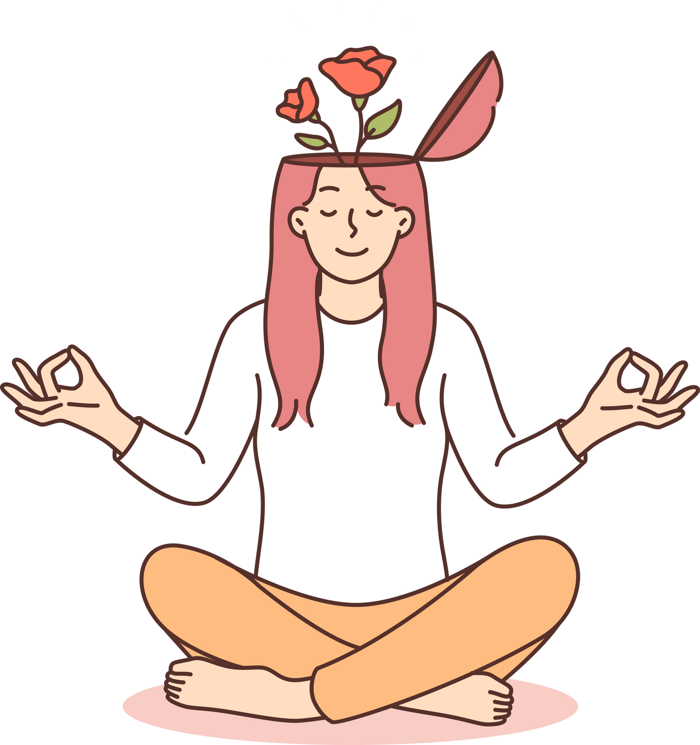
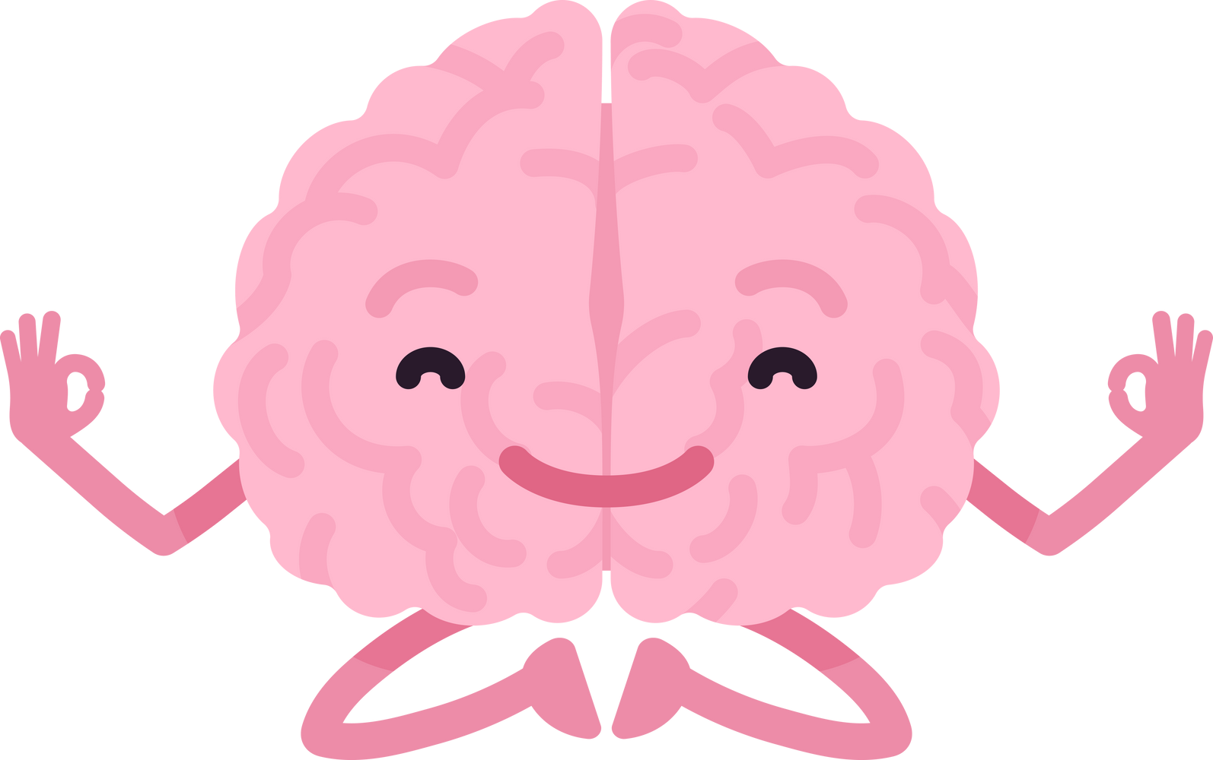
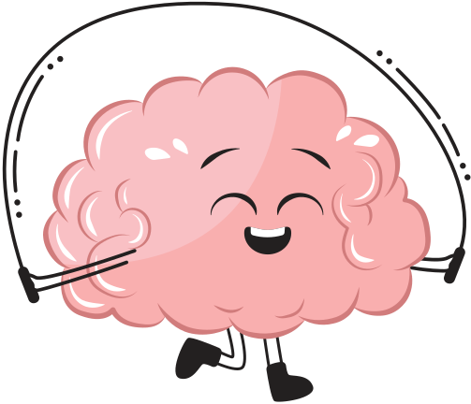
What mental health needs is more sunlight, more candor, and more unashamed conversation.
-Glenn Close
Hush_Hub
A place to escape reality

Slide 2




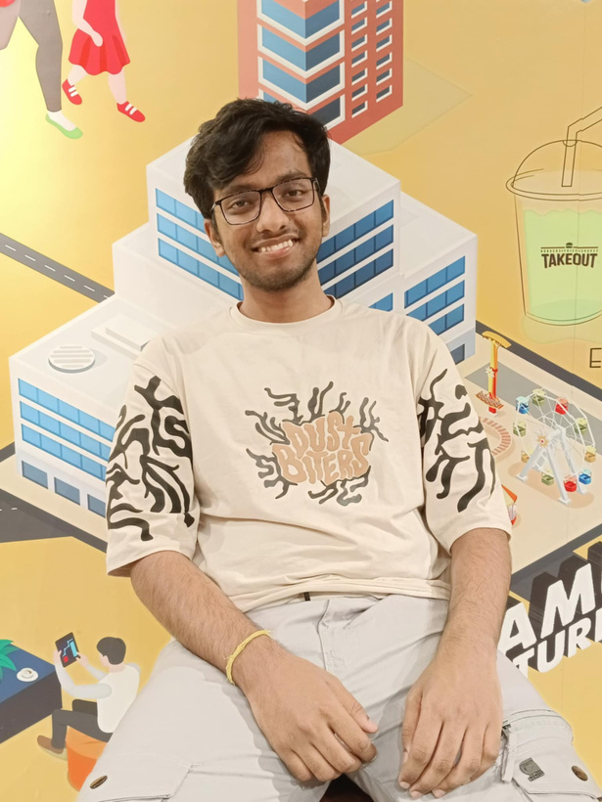
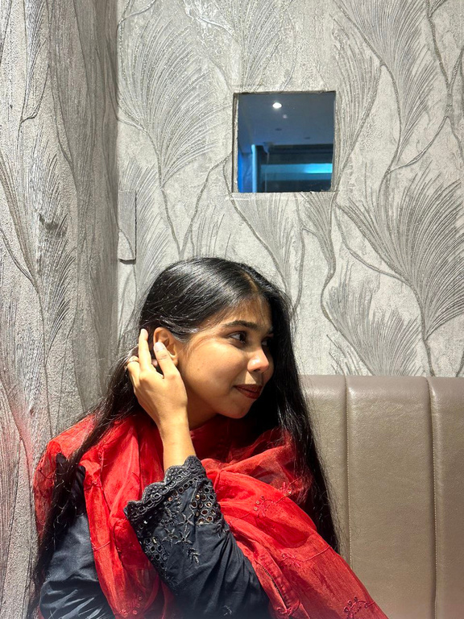

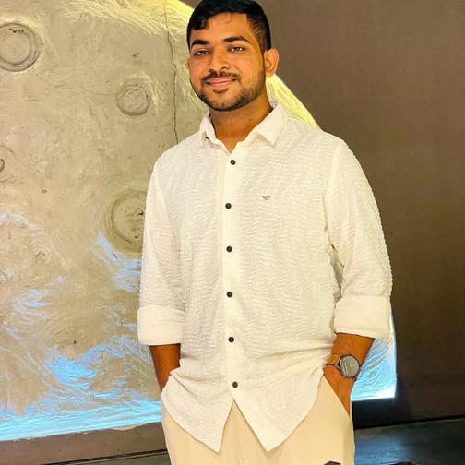


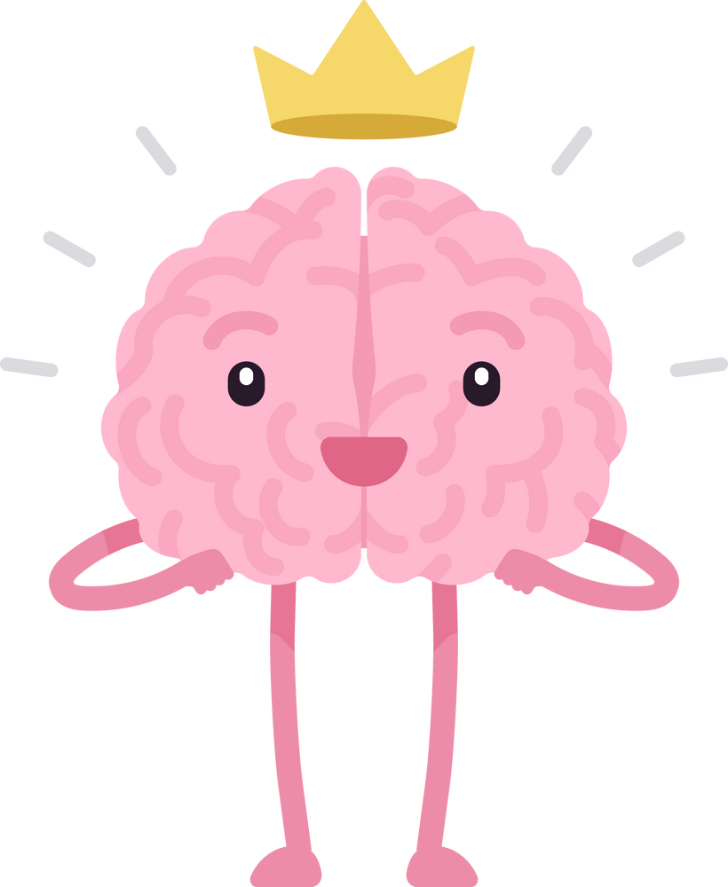
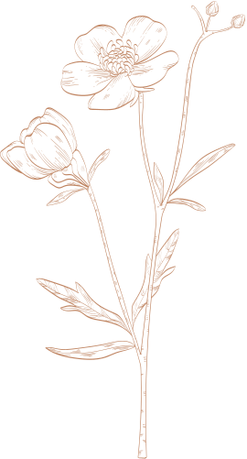
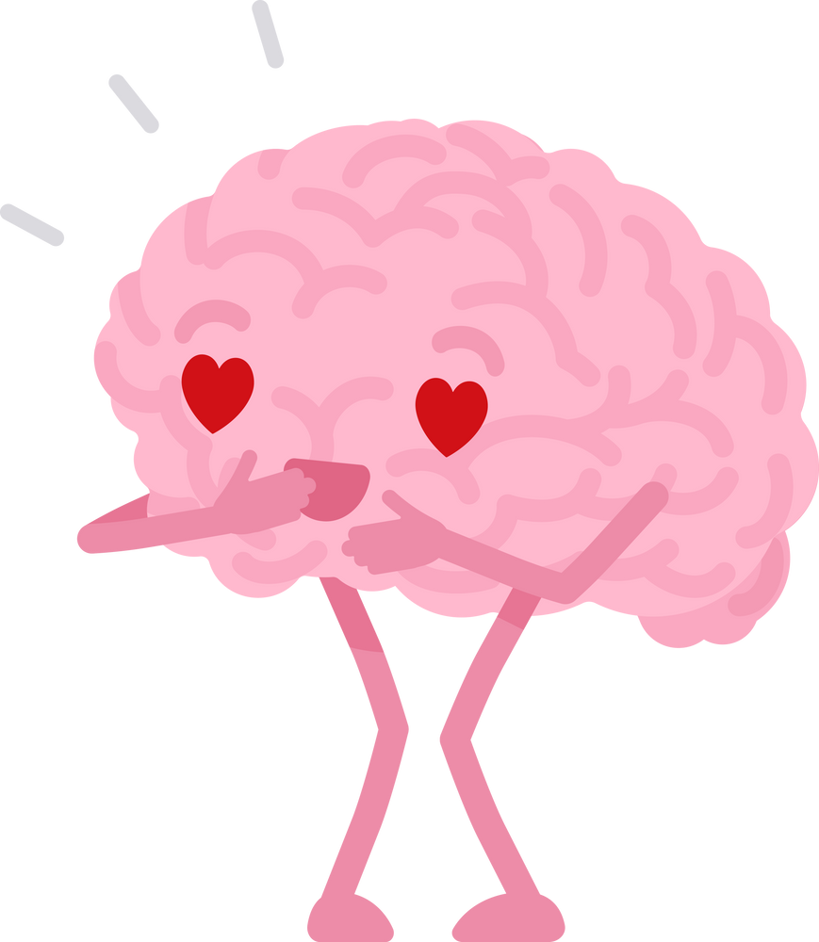
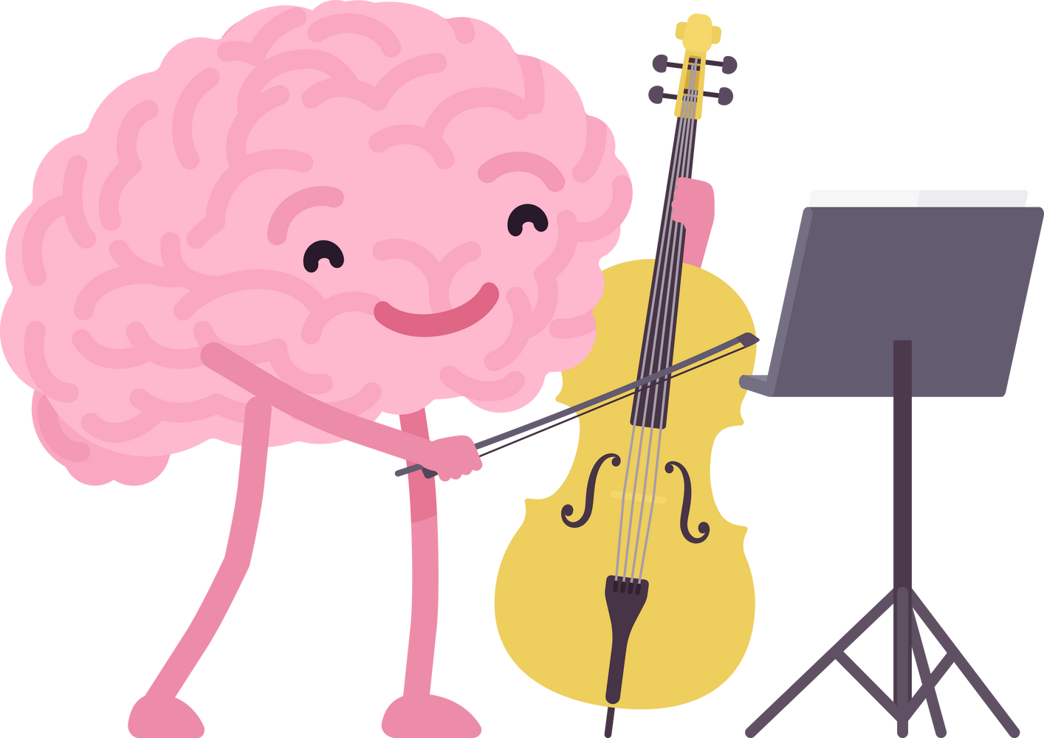
The Architects
Fatema Rahman
23101111
(🪼)
Lamiya Zaman
23101132
(🦋)
Swagoto Utshab Singha Roy
23101124
(😎)
Ragib Hasin Muktadir
23101131
(💪)
Jannatul Ferdoushi Islam
23101119
(🌻)

Slide 3

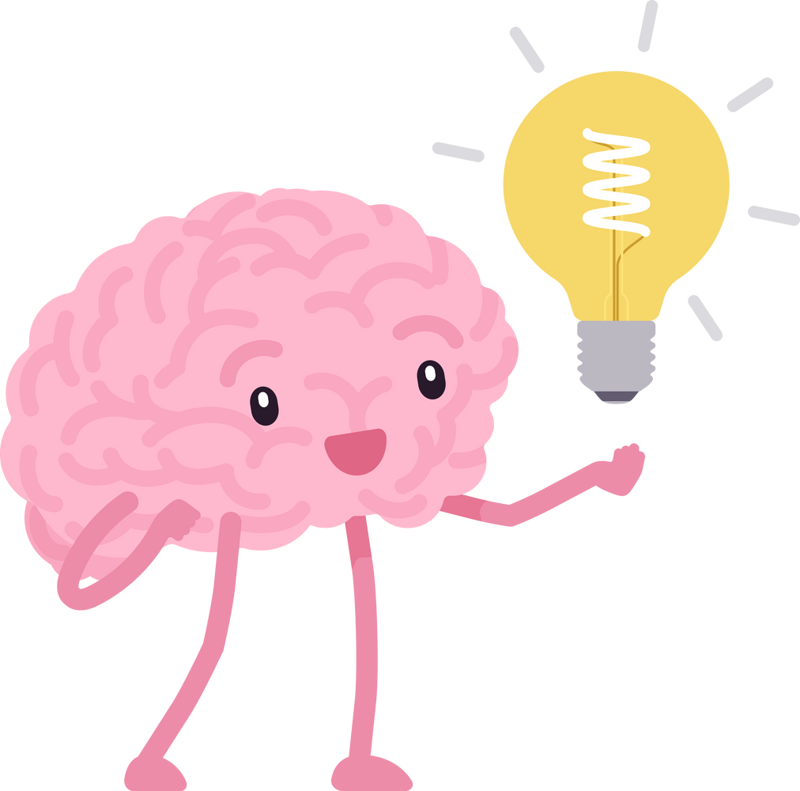

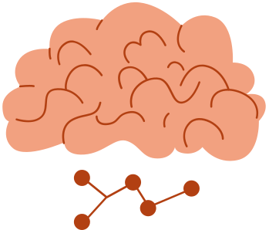
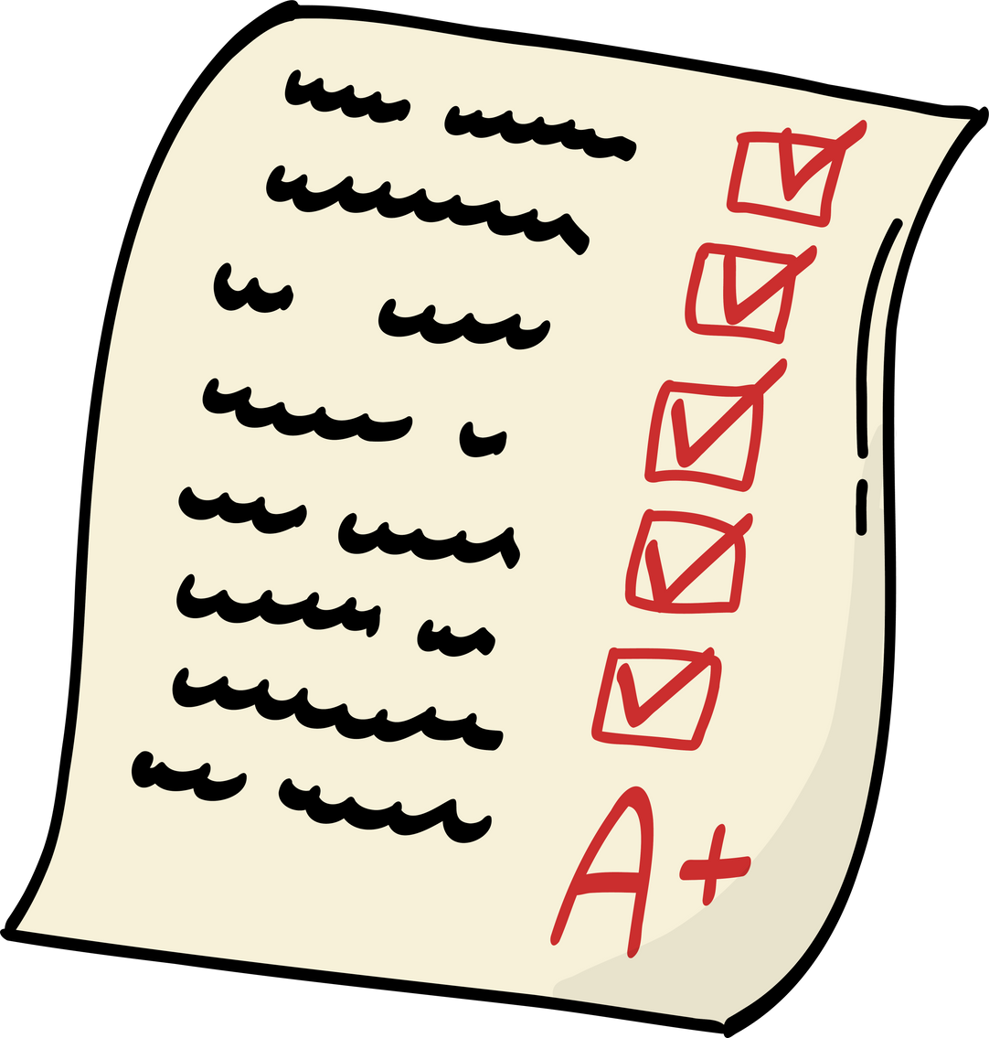
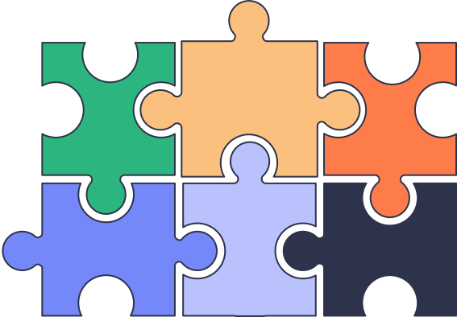
Hush_Hub Grand Tour!!
🤫 Break the Silence
We fight stigma with anonymous support — talk freely, without judgment.
🌱 Nurture Your Mind
Self-care made simple with smart tools like checklists ✅, trackers 📊, and meditations 🧘‍♀️.
🤝 Connect with Pros
No more confusion — easily book verified therapists 🧑‍⚕️📅.
🔥 Keep the Spark Alive
Stay motivated with progress badges 🏅 that reward your journey 🌟.
✨ Why We're Awesome_____
🧠 All-in-One: Complete mental wellness support.
🙋‍♀️ You-First: Private & easy to use.
💪 Built to Last: Reliable, solid tech.

Slide 4
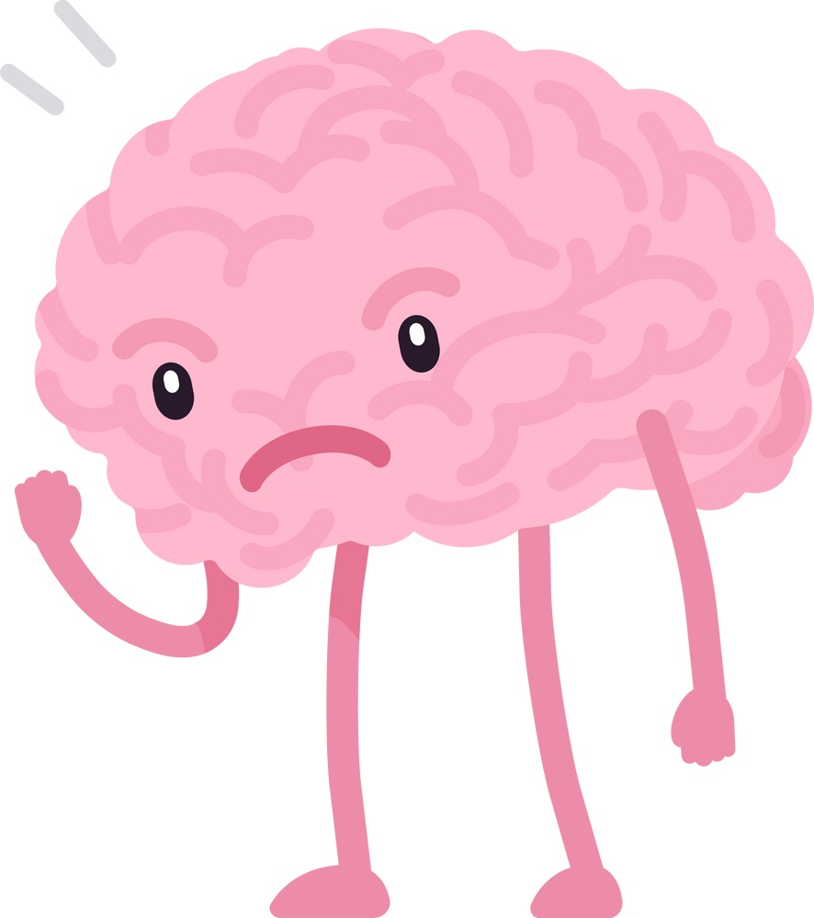
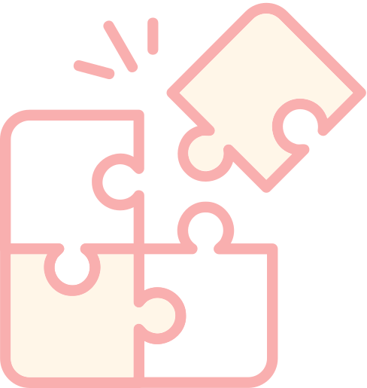


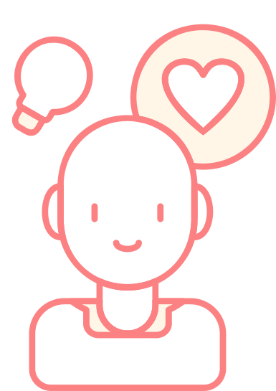
Problem Statement
Problem
Answers
Anonymous Support (User ID): Spill the beans, no names attached!
Checklists, Trackers, Meditations & Goodies: Your daily dose of zen, neatly packaged.
Therapist Booking System: Connect with pros, no dragons required.
Progress Badges: Level up your
well-being!
Afraid to talk, feeling alone.
"What even is self-care?" or "I keep forgetting!"
Finding a therapist feels like a quest.
Staying on track is tough.

Slide 5

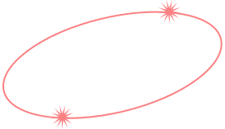



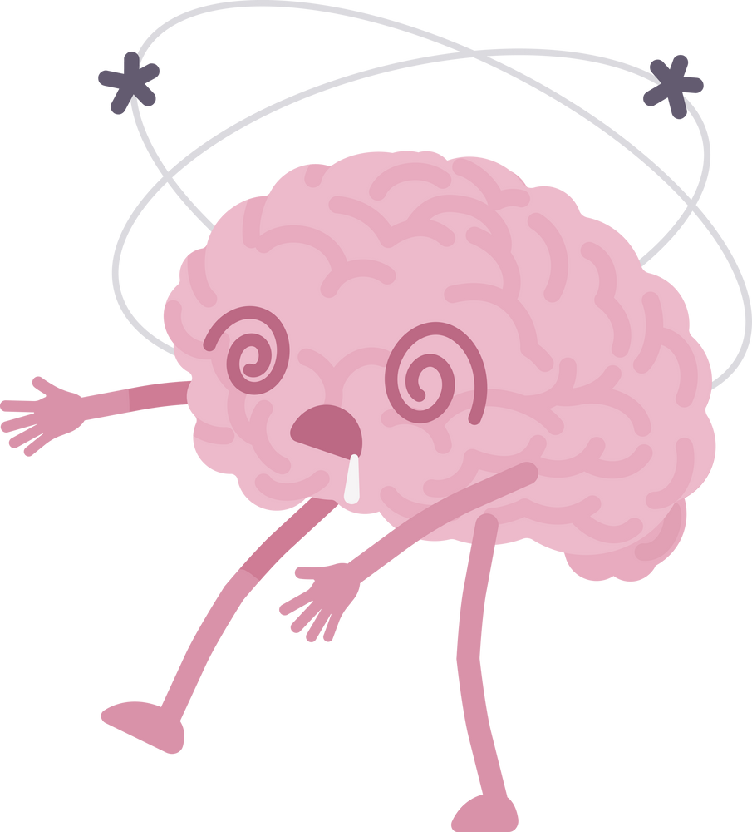
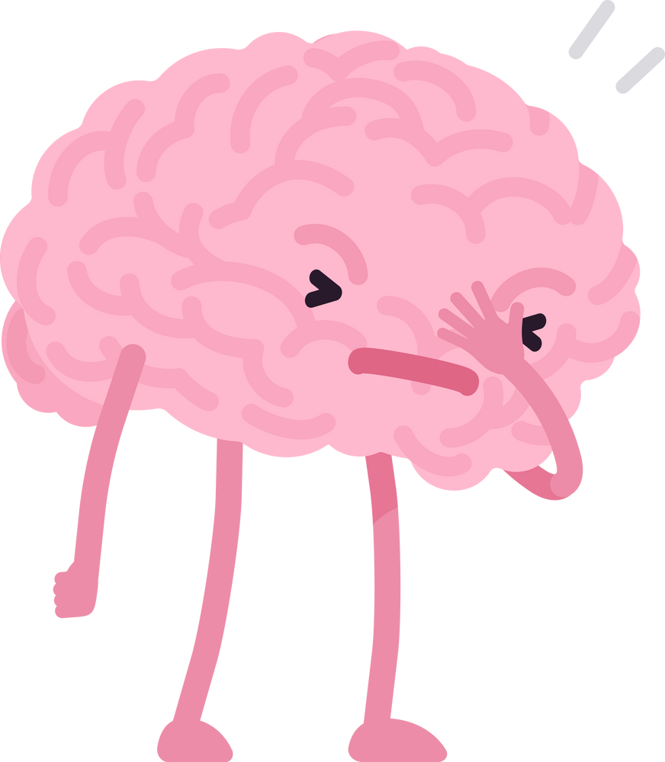
Anonymous Support
(User ID)
Therapist Booking System
A private and secure platform for peer-to-peer sharing and community connection without revealing identity.
A streamlined
process to discover and schedule appointments with verified
mental health
professionals.
Progress Badges
Curated Content Library
The Quest
Log
Gamified rewards to motivate consistent engagement with self-care activities and community
participatio
Vetted articles and resources for reliable mental health information.
Personalized Dashboard & Mood Journal
Self-Care Suite: Checklist · Routine Tracker · Guided Meditations · Content Library
Tailored insights and a private space for tracking and reflecting on personal well-being.
Tools for building healthy habits, practicing mindfulness, and accessing curated mental wellness resources.

Slide 6
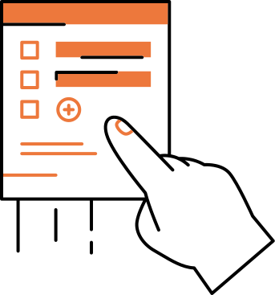



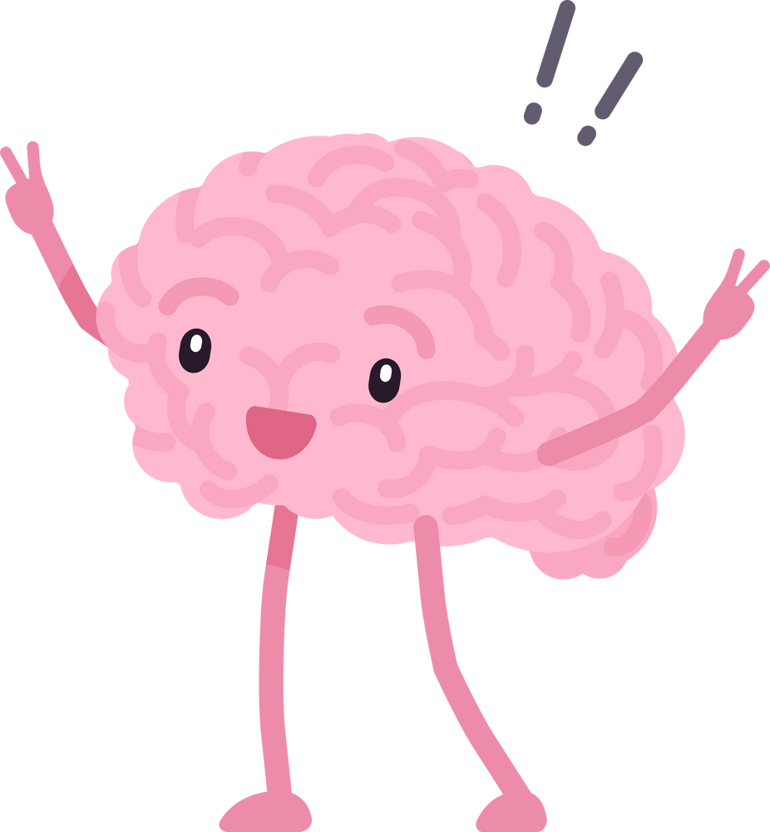




Hush_Hub's Secret Sauce
#Mind Map &
Mood Mixer
(Your Inner World,
Unpacked)
#Anonymous Support (User ID)
This feature goes beyond basic mood tracking or journaling 📔. It offers an interactive, dynamic way to explore and visualize your thoughts and emotions 💭✨,providing a deeper
and more engaging
self-reflection
tool 🧠🔍.
This feature prioritizes absolute privacy 🔒, letting users share sensitive experiences and support peers 🤝 without revealing their identity 👤. It creates a safe, judgment-free space 🌟 essential for open mental health discussions 🧠.
#Progress Badges
Our "Progress Badges" 🏅 encourage regular self-care 💆‍♀️ and active community participation 🤝. By rewarding your efforts, they make the often challenging journey of mental well-being 🧠 more enjoyable, motivating, and rewarding 🎉.

Slide 7

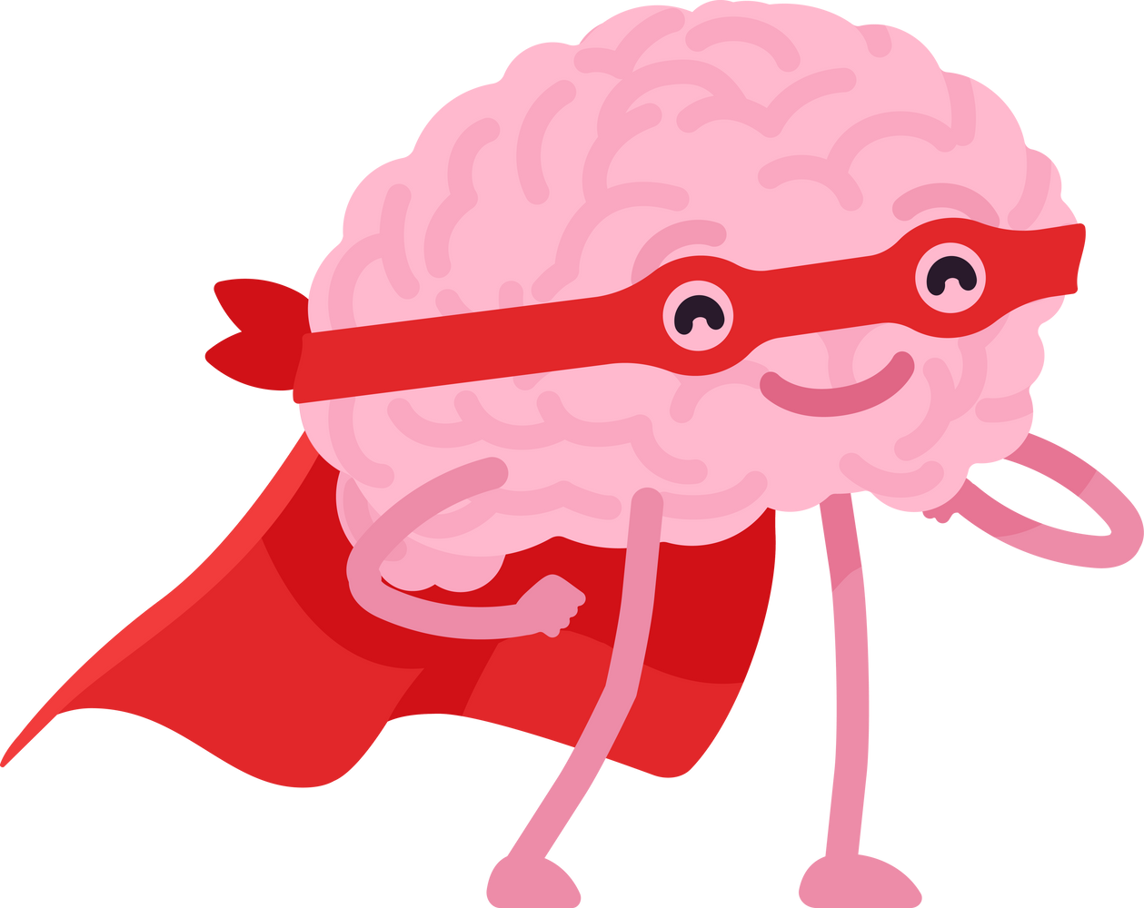



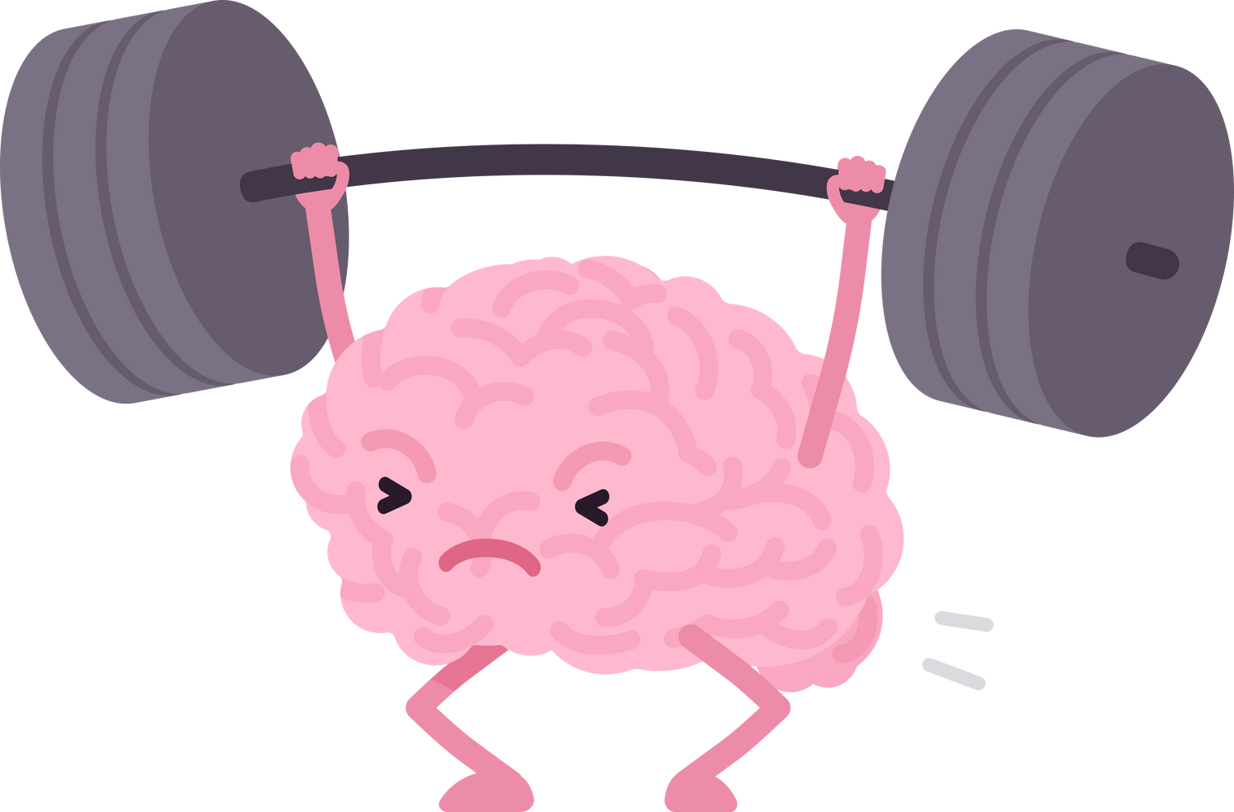
Seeds of Serenity
🧠💬 Breaking Down Stigma
🤝🌐 Fostering Community & Connection
💪🌿 Empowering Proactive Well-being
🏥📲 Increasing Access to Care
💻📘 Promoting Digital Literacy for Wellness

Slide 8
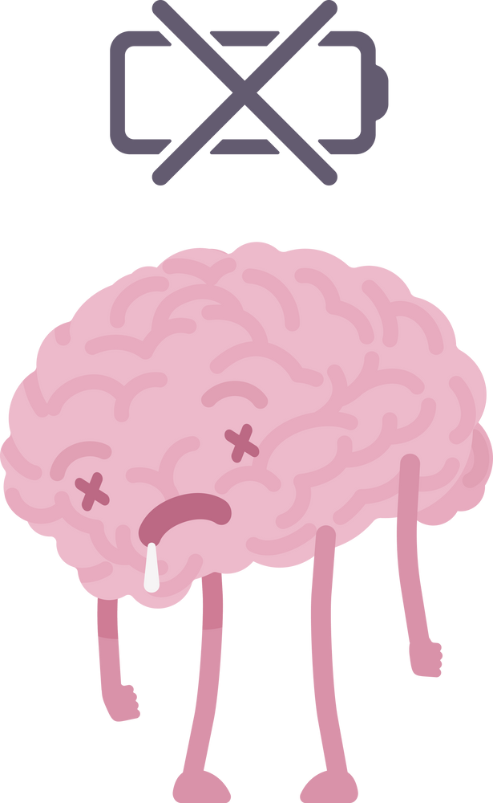
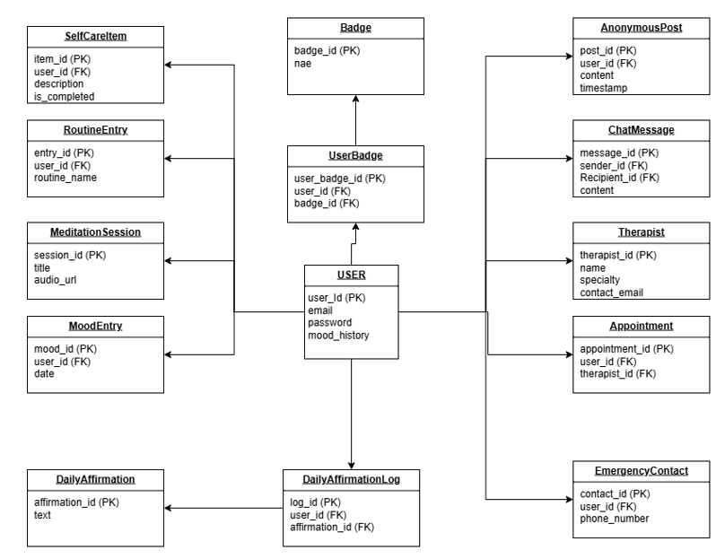
Class Diagram

Slide 9
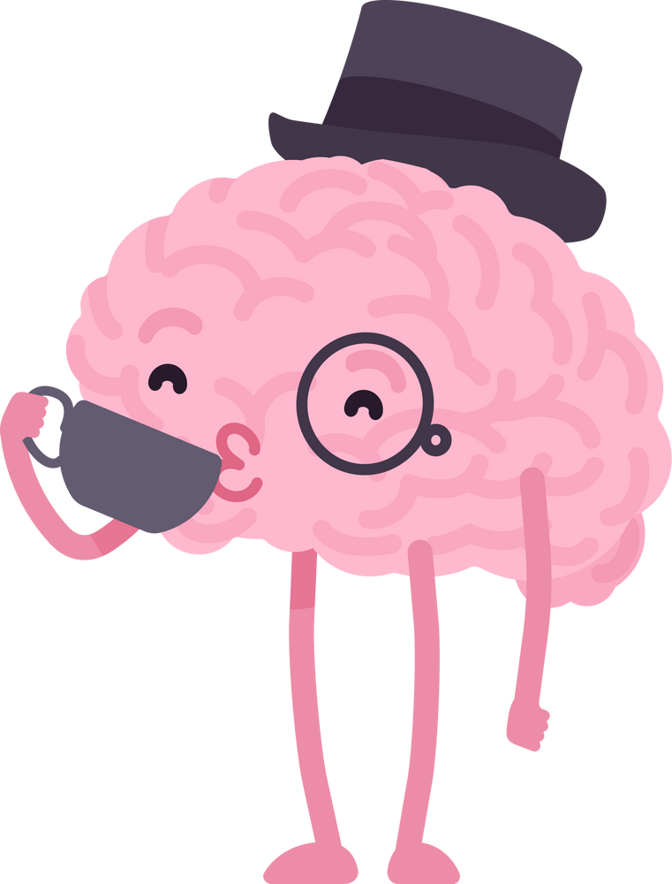



Zen Drop
So,🧐 What’s the Scoop?
We’re building Hush_Hub — your secret weapon againstthe mental health blues.
✔️ 💬 Anonymous chats,
✔️ 💆‍♀️ Self-care superpowers,
✔️ 🧑‍⚕️ Easy therapist hook-ups.
🎉 Join the Vibe
Tribe
Let’s make mental
well-being the coolest
trend around!
✨ Our Magic Touch
Wellness that’s fun, personal, and rewarding — no pressure, just progress.
🌍 The Big Picture
Not just an app — a movement for calm , connection , and
confidence .

Slide 10
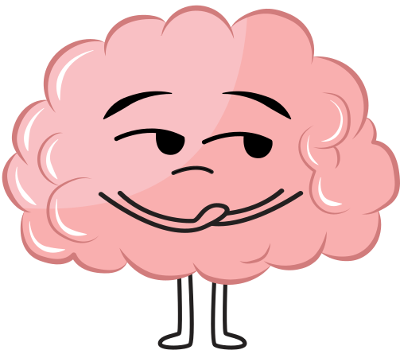
Any Question....??

Slide 11


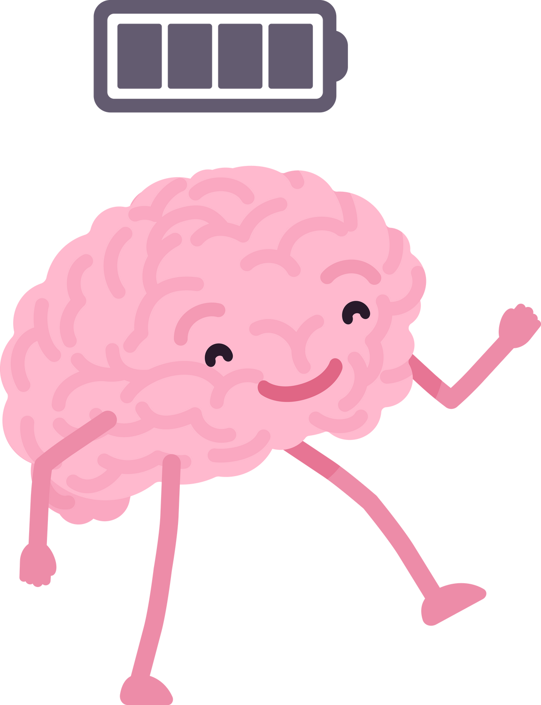
Calm Your Mind, Strengthen Your Body, Brighten Your Soul
Thank You
by this team....

